Slide 1
Dr. b. b. hegde first grade college, kundapura

Slide 2
Project Management
V Semester BBA- BBABMC 302
Mrs. Avitha Correa
Assistant Professor –
Commerce and Management

Slide 3
Subject Objective: To acquaint the students of Business Administration with different areas of Project Management and familiarise them with the parameters needed for preparation of a project.
Syllabus:
Unit 1- Project
Unit 2- Project Planning
Unit 3- Project Monitoring
Unit 4- Project Team Management
Unit 5- Closing the Project

Slide 4
Books for Reference:
Project Management – S Choudhury
Project Management – Nagarajan
Project Management – Bhavesh M Patel
Project Management – Yathish Kumar
Cases in Project Management – Sunil Abrol
Project Management - Gopalakrishnan

Slide 5
UNIT-1
PROJECT

Slide 7
Introduction / Meaning:
Project is a temporary group activity designed to produce a unique product, service or result. A project is accomplished by performing a set of activities. Project is the non-routine nature of activities, each project is unique. A project is initiated to achieve a mission, whatever the mission may be, a project is completed as soon as the mission is fulfilled.
Eg: Construction of a house is a project. The construction of a house consists of many activities. The construction of house project is accomplished by performing the set of activities.

Slide 8
A project consumes resources. The resources required for completing a project are men, materials, money and time. Therefore we can define a project as an organised programme of pre-determined group of activities that are non-routine in nature and that must be completed using available resources within the given time limit.

Slide 9
Definitions:
According to Harison, “a project can be defined as a non-routine, non-repetitive, one-off undertaking, normally with discrete time, financial and technical performance goals.”
According to the Encyclopedia of Management, project is ‘an organised unit dedicated to the attainment of goal-the successful completion of a development project on time, within budget, in conformance with pre-determined programme specifications.’

Slide 10
The Project Management Institute (PMI) defines a project as ‘a temporary endeavour undertaken to create a unique product or service.’

Slide 11
Characteristics of a project

Slide 12
Objectives : A project has fixed set of objectives. Once the objectives have been achieved the project ceases to exist.
Life Span : A project cannot continue endlessly. It has to come to an end.
Single Entity : A project is one entity and is normally entrusted to one responsibility centre while the participants in the project are many.

Slide 13
4) Team Work : A project calls for team work. Team constitutes of members from different disciplines, organisations & even different countries.
5) Life Cycle : A project has a life cycle reflected by growth, maturity and decay.
6) Uniqueness : No two projects are exactly similar. Each project is unique.
7) Change : A project sees many changes throughout its life

Slide 14
8) Made to Order : A project is always made to the order of its customer. The customer stipulates various requirements and puts constraints within which the project must be executed.
9) High level of sub-contracting : A high percentage of the work in a project is done through contractors. The more complexity of the project, the more will be the extent of contracting.

Slide 15
10) Risk and Uncertainty : Every project has risk and uncertainty associated with it. The degree of risk and uncertainty will depend on how a project has passed through its various life cycle stages. There cannot be a project without any risk and uncertainty.

Slide 16
Classification of project
Project managers have a lot to juggle, especially if they are working with multiple teams within a company.
Organisation of projects help to keep employees on track.
Dividing the projects into different categories is an effective way to balance tasks.

Slide 17
There are three common types of projects:
Business Projects
Developmental Projects
Technical Projects

Slide 18
Business Projects
A business project is a set of tasks, or it is a business process or system. A project is made up of a set of tasks that need to be completed by a variety of people within the organisation. The job of a project manager aims at ensuring all of these tasks are completed efficiently and on schedule, without compromising the quality of work required by the organisation. Business projects include anything that move the business strategy in a forward direction. It can include something basic as establishing a location for a certain business process or scheduling production.

Slide 19
b) Developmental Projects
They are usually a big part of researching and developing a new aspect of the business. This can involve the development of a new product or trying to migrate an existing product into new markets. In the development phase of any project there are not many tangibles, managing these projects involve a lot of foresight and goal setting from the project manager. It is up to the project manager to give a clear vision for the road ahead for any developmental project.

Slide 20
c) Technical Projects
These are among the most complex in any business environment and are usually closely connected to Information Technology (IT) processes. Many of these projects are aimed at improving the IT infrastructure supporting the entire organisation. Technical based projects are usually carried out in five key stages: initiation, planning, executing, controlling & closing. Many of the Technical Projects are usually in partnership with an IT Project Manager & with Chief Information Officer (CIO).

Slide 22
Risk means a set of uncertain events.
Project risk means a set of uncertain events involved in the project life, if it occurs, it has a positive or negative effect on the prospects of achieving project objectives.
Project risk management involves anticipation of uncertain events that are inherent to the project in order to optimise them for project success.

Slide 24
Kinds / Types of Project Risks:
Projects face a host of risks. Some important risks are as under:
Project Completion Risk: Completing the project on time and within the estimated cost itself is a major achievement. A project that is delayed will result in time over-run which will consequently result in cost over-run. If the project promoters are not able to pump in additional funds required to meet the cost over-run, the project runs the risk of coming to a halt.

Slide 25
When project promoters find it difficult to meet the interest commitment on the borrowed funds, the lenders may not be prepared to fund the project additionally to meet the cost over-run. Once symptoms of delay in project implementation occurs, collecting additional funds becomes difficult, which will add to the problem of project completion. There can be technology failures, which may result in non-completion of projects. For projects with long development / growth period in the fields of fast developing technology, there is risk of project not being completed due to technological vanishment during the course of project implementation.

Slide 26
2. Resource Risk: Raw materials, power, fuel, manpower etc, are the resources used by a project. Shortage of raw materials may lead to reduction in capacity utilization and higher cost of production, which will make all profitability estimates wrong. Due to shortage of resources the project profitability calculations and the project may run the risk of not earning the estimated returns.

Slide 27
3. Price Risk: Price fluctuations of both inputs and outputs (i.e raw materials and finished products) affect the projects. Unforeseen happenings such as Government’s intervention in price fixation, ability of competitors to offer their product to customers at a comparatively cheaper price etc, are likely to have an adverse effect.

Slide 28
4. Technology Risk: Technology risk may appear in two forms. A project that is based on unproven technology (i.e a technology that is proved in laboratory but not proved commercially) may have hidden defects which may make the project a non-starter. Rapid growth in technology may make a project obsolete in technology due to the evolution of latest technology.

Slide 29
5. Political Risk: The Government acts as a watch dog of the country’s economy and frame rules and regulations for regulating the country’s economy. The Government intervenes in many forms such as levying and regulating taxes, regulating monopolistic trade practices, imposing import duties, promoting exports, prohibiting export of certain commodities, issuing import licenses, controlling foreign exchange transactions, price controls, expropriation, nationalization etc. Political risk is a major risk since it cannot be predicted easily.

Slide 30
6. Interest Rate Risk: Fluctuations in interest rate may bring in an adverse effect. Eg: If project is funded by way of long-term borrowings at a particular rate of interest and if the interest rate falls down subsequently, the project that availed long-term borrowing at a higher interest rate has to repay the loan only at the higher rate of interest. New entrants who set up similar projects may have access to long-term loans at the prevailing rate of interest which may be cheaper. In such a situation, projects that were implemented with high-cost borrowings will find it difficult to compete with the new entrants.

Slide 31
On the other hand, if the interest rate increases in future, the interest on working capital finance increases, which will result in lower profit margins than estimated at the time of project appraisal.
7. Exchange Rate Risk: It is also called Currency Risk. It is the risk arising from currency fluctuations. Volatile exchange rates can reduce cost and productivity advantages gained over years of hard work. Firms exposed to international economy face this risk.

Slide 32
When the firm has entered into an agreement agreeing to make foreign currency denominated transaction / payments or agreeing to receive payments in foreign currency, the firm is exposed to exchange rate risk. The firm will incur loss if the exchange rate of the foreign currency has moved adversely and will earn profit if the exchange rate has moved favourably.

Slide 34
Project Management is a methodical approach to planning and guiding project processes from the beginning to the end.
Project Management is an organized venture for managing projects. It involves scientific application of modern tools and techniques in planning, financing, implementing, monitoring, controlling and coordinating unique activities or tasks to produce desirable outputs in accordance with the pre-determined objectives within the constraints of time & cost.

Slide 35
Project Management refers to the management of projects, which are temporary, non-routine, one time endeavor, undertaken for producing a definite product or offering an unique service.
Definition:
Project Management Institute (PMI) defines project management as “the application of knowledge, skills, tools and techniques to a broad range of activities in order to meet the requirements of a particular project.”

Slide 36
Objectives of Project Management:

Slide 37
The main objectives of project management are:
To agree exactly what a project is meant to do and what it is meant to deliver
To agree the scope, timescales, cost and quality of a project
To maintain a schedule and project plan
To deliver the agreed outcomes of the project to the right scope, timescales, cost & quality
To manage risks, issues etc

Slide 38
To provide communications, reports and progress updates throughout the lifecycle of the project
To make sure that the business gets the outcome that it wants from the project
To manage policies, processes, tools, frameworks, techniques, people & relationships to a successful project outcome
To minimize any impact on normal business operations

Slide 39
Importance of Project Management:
Project Management is a growing field used increasingly by businesses of all sizes. As entrepreneurs and company executives deal with the daily responsibilities of managing an organization, it is important to use dedicated project managers to oversee projects from conception to completion.

Slide 40
Project Management is the art of managing the project and its deliverables with a view to produce finished products or service.
Project Management includes identifying requirements, establishing clear and achievable objectives, balancing the competing demands from the different stakeholders and ensuring that a commodity of purpose is achieved.

Slide 41
It is clear that unless there is a structured and scientific approach to project, managements would find it difficult to meet the challenges of modern era.
There are some reasons why organisations must take the practice of project management seriously.
Without a scientific approach to the task of managing the projects & achieving objectives, it would be very difficult for the organisations to successfully execute the projects within the constraints of time scope and quality and deliver the required results.

Slide 42
There has to be a framework and a defined way of doing things to ensure that there is a structure to the art of project management.
Without the use of project management, managers and organisations would find themselves facing an unpredictable & confusing environment over which they have little control. So project management is both necessary and essential to the success of the project.
It is important to note that project management provides a framework within which subsequent actions by the organisation can be taken.

Slide 43
a) Organising Chaos: Projects are naturally confusing. The primary business function of project management is organizing & planning projects to decompress the disorderliness (Chaos). Project Management is the organization, planning and control of projects.
b) Managing Risk: Any good project has plenty of risk. Risk is a fundamental part of business strategy. It is that chance of negative event or loss. Project Management identifies, manages and controls risk.

Slide 44
c) Managing Quality: Quality is the value of what you produce. There is not much sense producing something that has no value. Project Management identifies, manages and controls quality.
d) Managing Integration: Projects need to be integrated with business processes, systems and organisations. Integration is often key to project value.

Slide 45
e) Managing Change: Projects always happen in an environment in which nothing is constant. Projects are always a moving target. Change is not optional, change happens whether you manage it or not.
f) Clearing Issues: Business activities typically encounter regular issues or problems, that must be manageable. Project Management plays a critical role in identifying and clearing issues.

Slide 46
g) Retaining and using knowledge: Projects generate knowledge. Knowledge represents significant asset for most businesses. Project management ensures that project knowledge is captured and managed.
h) Learning from failure: Projects often fail. Learning from failure is key to business innovation and quality improvement. Project Management ensures that lessons are learnt from project success and failure.

Slide 47
Importance of Project Management – Mainly with consideration to Risk Management:
Risk Management is basically an approach in which we explore, identify, analyse and to lessen the risks that can affect our project. Risk Management is an essence of Project Management. It increases the chances of your success upto a great extent.

Slide 48
The benefits of developing an efficient risk management in project management while working on any project:
Helps you to avoid any big disaster
Enhances revenues by saving your expenses
Provides mental satisfaction
Ensures the successful completion of project
Gives competitive edge over others
Increases the sense of responsibility
Helps you to explore new opportunities

Slide 49
The risk in project management refers to a range of possibilities that cause an adverse event and therefore the results prior to the event. Risk in Project Management can be identified, estimated, assessed & controlled. Management of project risk can be described as a complex process of planning, identification, analysis, evaluation & control of project risks.

Slide 50
Identifying risks in a project is a basic step in the project management. Through special tools to identify risks, all data collected and analysed with the aim to identify risks is an essential basis for risk analysis in projects, risk assessment and moreover, for an accurate survey of the future risks.
Risk identification in project management is the process of determining which risks may affect the project and recording their characteristics.

Slide 51
The problem of identifying risks in project and how to find the solution of solving can be treated successfully if the project manager & management team knows how to identify risks and eliminate the risks.
Project Manager establishes a system of risk identification and to lessens the risk, i.e.,
Project Management Team- with hiring experts in project
Project Organisation-includes documents, communication tools, time management etc.

Slide 52
c) Technical Problem-Team of technical experts who know to perform risk analysis and how to manage the risk.
d) Software tools for identifying risks-it allows project manager to plan and control the process of risk identification.
The purpose of Project Management in managing the risk is to identify and estimate possible threats and then choosing the appropriate method to reduce or eliminate hazards. This will help the project managers and stakeholders of project management.

Slide 53
Scope of project management:
Scope involves getting information required to start a project. Project scope means, “The work that needs to be accomplished to deliver a product, service or result with the specified features and functions.
Project scope is the part of project planning that involves determining & documenting a list of specific project goals and dead lines. Project scope allows the project manager to estimate the time & cost required to finish the project.

Slide 54
Project Management includes a set of core activities that help to achieve project goals and objectives. The aim of Project Management is to achieve all project goals & objectives while keeping in mind the limits within which these must be achieved.
Project Management covers the following areas as the part of its scope. They are initialisation, planning and development, project execution, project monitoring and project closing.

Slide 55
The project manager must be able to effectively communicate requirements, handle the decision making process with respect to project scope & goals, manage employee activities, build a good team and allocate resources according to the requirements.
As the part of the management process it should make use of tools that help them to organise tasks, track hours etc. In order to keep the project in right track it is essential to have project control mechanisms in place.

Slide 56
The appropriate level of control must be implemented, too much control can be really time consuming while less control can make the project go out of hand. A project’s success is determined if or not the project was within the stipulated time period and within the set budget & if it has met customer reqirements.

Slide 57
Time
Cost
Quality

Slide 58
Project management v/s general management
Project Management | General Management
1. It is usually employed in projects that are temporary & time constrained. | 1. It is employed for on-going procedures/functions of certain organisations/businesses etc.
2. Usually resources are limited. | 2. It is responsible for resourcing whatever necessary ingredients/items are required for the continuation of functions.
3. It often falls under the broad discipline of management, it is a part of General Management. | 3. It is an academic discipline taught in Schools & Universities.
4. It has beginning and completion point. | 4. G.M activities are on going, there is no beginning or end.
5. Project Manager need not necessarily be a senior employee. | 5. General Manager is always a senior employee.

Slide 60
The Project Manager
Inspite of computers and sophisticated software packages we would still need a project manager to make a project a success.

Slide 62
Role of Project Manager
A Project Manager is a person who has the overall responsibility for the successful initiation, planning, design, execution, monitoring, controlling and closure of a project.
Construction, Petrochemical, Architecture, Information Technology and many different industries that produce products and services use this job title.

Slide 63
The Project Manager must have a combination of skills including an ability to ask penetrating questions, detect unstated assumptions and resolve conflicts, as well as more general management skills.
Important among a project manager’s duties is the recognition that risk directly impacts the likelihood of success and that this risk must be both formally and informally measured throughout the lifetime of a project.

Slide 64
Risk arises from uncertainty and the successful project manager is the one who focuses on this as their primary concern.
Most of the issues that impact a project result in one way or another from risk. A good project manger can lessen risk significantly, often by adhering to a policy of open communication, ensuring every significant participant has an opportunity to express opinions and concerns.

Slide 65
A Project Manager is a person who is responsible for making decisions, both large and small. The project manager should make sure they control risk and minimise uncertainty. Every decision the project manager makes directly benefits their project.
Project Managers use project management software such as Microsoft Project to organise their tasks and workforce. These software packages allow project managers to produce reports and charts in a few minutes compared with several hours it can take if they do it by hand.

Slide 66
Roles & Responsibilities of Project Manager include many activities:
Planning & Defining scope
Activity Planning & Sequencing
Resource Planning
Developing Schedules
Time Estimating
Cost Estimating

Slide 67
Developing a Budget
Documentation
Creating Charts & Schedules
Risk Analysis
Managing Risks & Issues
Monitoring & Reporting Progress
Team Leadership
Strategic Influencing

Slide 68
Business Partnering
Working with vendors
Probability Analysis
Controlling Quality
Benefit Realisation
Finally, senior management must give support and authority to a project manager if he/she is going to be successful.

Slide 71
A Project Manager must define what a project will achieve and then ensure it meets those goals. Project Managers communicate with upper management and outside vendors and clients as needed. In fact, proactive communication is one of a project manager’s most important functions.

Slide 72
Skilled Project Managers are invaluable to businesses. This speciality fulfils an increasingly important role in many companies. Project Managers oversee the individual tasks that move a project towards completion, so the ultimate success or failure of a project depends in large part on the project manager’s competency.

Slide 73
In companies where projects are frequently late, over budget or fail to meet their objectives, hiring a skilled project manager can improve productivity and morale and often leads to generate profitability.
The more project manager’s skills a company’s leaders have, the greater is its success.
Strong project managers adjust their decisiveness level to each situation. Skilled project manager is a well-rounded leader.

Slide 74
Companies may have difficulty in fulfilling sales and profit goals, efficiency and productivity objectives and shareholder expectations without the leadership of skilled project managers.
Project Manager is important in
Keeping projects on schedule
Delivering on customer expectations
Maintaining product or service quality

Slide 75
d) Fostering a strong company culture
e) Helping staff succeed in their roles
f) Keeping costs on budget
g) Contributing to company profits
Successful project managers build strong teams to carry a project from inception to completion.

Slide 76
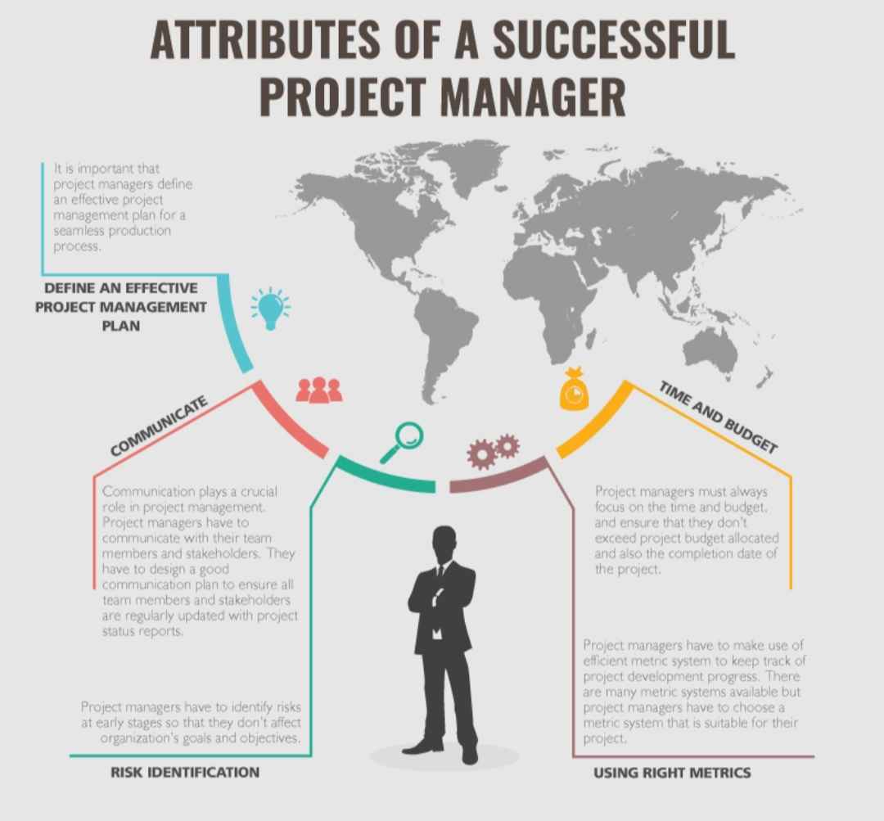

Slide 77
Attributes of a Good Project Manager:
An effective project manager is one who should have the following skills/capacities
Planning and Organisational Skills
Personnel Management Skills
Communication Skills
Change Orientation
Ability to solve problems

Slide 78
High energy levels
Ambition for achievement
Ability to take suggestion
Understanding the views of project team members
Ability to develop alternative actions quickly
Effective time management
Ability to handle project management softwares
Solving issues/Problems immediately

Slide 79
Initiative & risk taking ability
Conflict resolving capacity
Team building skills
Entrepreneurial skills

Slide 80
Project Identification:
Identifying a new project is a complex problem. It involves careful study from many angles.
Project Identification is a repeatable process for documenting, validating, ranking and approving projects within an organisation. The Project Identification process considers competing business needs, staff availability and financial implications before selecting a project for Project Initiation.

Slide 81
Project Identification Process/Process in Identification:
Due to changing financial conditions within the organisation, it is necessary to establish a stable process for recognizing and approving projects for initiation. This process makes project initiation faster and more efficient.

Slide 82
Process:
I Capture Candidate (Hopeful/Eligible) Projects
An initiative proposal has been submitted and the organisation’s senior decision makers have determined it has merit and should be considered for Project Initiation. The initiative proposal is now a candidate project and should be captured in a repository for ranking and selection.

Slide 83
II Rank Candidate (Eligible) Projects
At regular intervals (monthly, quarterly, semi-annually etc) all eligible projects that are in the repository should be ranked based on objective criteria such as,
Target due dates
Impact on the total business
Project size, cost & duration
Project Risk
Each organisation should establish the criteria it considers significant for this ranking.

Slide 84
III Evaluate Human Resources
Maintaining a skills inventory of all corporate resources that are available for project assignment. An inventory of available contract resources should also be captured. The purpose of this skills inventory is to understand the true capabilities and capacities of the human resources.

Slide 85
IV Determine Human Resource Needs
By evaluating the skills inventory and the human resources needed by the candidate projects, anticipate the skill types and skill quantities that will be required to support eligible projects when they are selected for Project Initiation.
This will help to identify when specific skills will be required, create training for needed skills, provide a basis for employment opportunities etc.

Slide 86
V Approve Project for Initiation
Based on the information provided by the ranking process, the organisation’s senior decision makers select a specific eligible project for Initiation. A project owner and Project Manager are assigned to the approved project. Members of the project team may also be assigned. Project Initiation activities tend to begin.

Slide 87
Taxonomy (Categories) of project
The term ‘taxonomy’ refers to the science of classifying things by naming and identifying them. Projects can be classified under different heads
Based on the Type of Activity:
Under this category, projects can be classified as industrial projects and non-industrial projects.
Industrial Projects are set up for the production of some goods. The importance of such projects is profit making. Simple engineering processes and methods are executed in industrial projects.

Slide 88
It is involved in the engineering and construction activities. The projects initiated in one’s own country with an objective to make money and for commercialisation are called Industrial Projects. Eg: A car manufacturing is an Industrial Project.
Non-Industrial Projects are those which are done for the upliftment of the society and majorly done with social welfare objectives. The intention of such projects is non-profit making. No production takes place here.

Slide 89
Eg: Building a canal, agricultural development, educational projects, irrigation projects, pollution control projects, high-way projects, water supply projects etc. These projects are mainly carried up by the Government and the benefits are enjoyed by the entire society.
II. Based on the Location
The projects are classified as National Projects and International Projects. These projects are categorised on the basis of geographical location set as countries.

Slide 90
National Projects are those set up within the national boundaries of a country, or the projects done in one’s own country, then it is said to be domestic project. This project can be undertaken either by Private Concerns or by only Government bodies.
International Projects- if one country tries to build projects with other foreign country such projects are said to be International Projects. It is carried out between two or more nations & set up by the Private or Govt. bodies.

Slide 91
Eg: Setting up fully owned subsidiaries abroad.
Setting up joint ventures abroad.
Setting up of projects abroad by way of mergers and acquisitions.
Handling of international projects need more expertise and greater efforts in view of higher risk and formalities involved.

Slide 92
III. Based on Project Completion Time
Based on the constraints on project completion time, projects can be classified into two types a) Normal Projects b) Crash Projects.
Normal projects are those for which the time limits are set and adequate. There is no constraint on time.
Crash Projects are those which are to be completed within a stipulated time, even at the cost of ending up with a higher project cost.

Slide 93
Eg: Construction of canal lining with the condition that the work should be completed before the monsoon starts- is a Crash Project.
IV. Based on Ownership
It can be classified into a) Private Sector Projects
b) Public Sector Projects & c) Joint Sector Projects

Slide 94
Private Sector Projects are projects with a complete ownership of promoters and investors. Owners may be an individual, partnership firm or a company. These projects are mostly done with an objective to earn profit and thus have a commercial nature, i.e only with the sole idea of earning better returns.
Public Sector Projects are those that are owned by the State, Central or both forms of Governments. The growth of public sector projects is the natural outcome of the efforts of Governments for undertaking developments in a country.

Slide 95
Joint Sector Projects are those in which the ownership is shared by the Government and by Private Entrepreneurs. The main consideration for the Government’s investment in Joint Sector Projects is to make use of the managerial talents, entrepreneurial capabilities and marketing skills of the private entrepreneurs. Joint sector offers hope to the private entrepreneurs since the Government shares the investment required for the Project.
Eg: Project of Metro Train, Dams, IT Parks, Electricity Plants etc.

Slide 96
V. Based on Size
These projects are based on investment size or capacity of plant to offer goods or services. They are further classified into small, medium and large scale projects. The investment limit for the different categories of projects are announced by the Government and this undergoes periodical changes keeping in view the inflation, the decision to offer certain incentives to projects that are categorised as ‘small scale’ projects etc.

Slide 97
As per the directives of the Govt. of India, the projects with investment on plant & Machinery upto ₹ 1 Crore are categorised as ‘small scale projects’ while those with investment in Plant & Machinery above ₹ 100 Crores are categorised as ‘large scale projects’. Projects with investment limit between these two categories are ‘medium scale projects’.

Slide 98
VI. Need based Projects
Projects are basically driven by certain needs of the organisation and these needs further form the basis of project categorisation. They are classified as under:
a) New Project: A new project idea is conceived and implemented to meet the customer needs. A new project can be one that identifies a new product for which there is demand from the customers or it can be a project for the production of a product that is already in the market but the demand for which is in excess of the supply. Identification and formulation of a new project requires special knowledge & skill.

Slide 99
b) Balancing Project: Projects in general have many production units that are linked with one another. The flow of materials through different production units shall be such that the output of one production unit exactly matches the input requirement for the subsequent production unit. If this is so, the efficiency of the production line will be the maximum and there will not be any under utilisation of production capacity. However, if the production capacity of any particular production unit is less, then this particular production unit sets the maximum limit of production possible for all other units.

Slide 100
c) Expansion Project: An expansion project is one that is aimed at increasing the plant capacity for the current product range. It is undertaken when the production capacity of goods and services is to be increased.
Eg: Production of watches from 50,000 units to 75,000 units.
Expansion of plant capacity can be done in two ways:
By establishing additional plant capacity
b) By acquisition of another organisation in same line of activity

Slide 101
Expansion Projects are supported only where there is definite upward trend in the demand for the product and only after the management of the organisation is doubly confident about the long term prospects of the expansion scheme.
d) Modernisation Project: Upgrading the technology to increase the productivity and inevitable approach of technology. Technological innovation is a continuous process. When a new technology is evolved and becomes commercially operative, the existing technology becomes obsolete.

Slide 102
Any project is set up with the latest available technology. With the passage of time in view of continuing technological upgradation, the projects become obsolete in technology.
e) Replacement Project: Replacement Project involves replacing some of the old machinery with new machinery of the same capacity. Due to ageing and wear and tear of machinery, the maintenance cost starts mounting up and a stage will come when it will be no more advantageous

Slide 103
to keep the worn-out machinery in the production line in view of abnormally high maintenance costs, poor quality of output, break down etc. hence a replacement project is implemented to reduce the maintenance cost of old machinery and to keep the production going without any obstruction so that delivery schedules are met in time.
Thus replacement projects are undertaken with a view to maintaining the same level of operational efficiency or even to better the level of operational efficiency wherever possible.

Slide 104
f) Diversification Project: Projects undertaken by the organisation to completely divert from its core business is called diversification project. When a manufacturer wants to offer more than one product, it is described as product diversification and the project meant for this purpose is the diversification project. Eg: If a petroleum Co. decided to enter into IT business.

Slide 105
g) Rehabilitation Project: When a project is started to revive a loss bearing company, it is known as Rehabilitation Project.
h) Plant Relocation Project: When an organisation decides to shift its plant from one location to another, the project started there will be known as Relocation Project.
i)Backward Integration Project: It is the project where the manufacturing facilities are added at the initial stage itself.
j) Forward Integration Project: These are the projects where the manufacturing facilities are added to the existing line of production at the end of the production process.

Slide 106
PROJECT MANAGEMENT LIFE CYCLE
At the start of a project, the amount of planning and work required can be very vast and huge. There may be hundreds of tasks that need to be completed at just the right time and in just the right sequence.
No matter what project it is being preparing for, the project management life cycle can assist the project team in narrowing the project’s focus, keeping it’s objectives in order and finishing the project on time, on budget and with a minimum of risks.

Slide 107
Every Project Management Life Cycle contains five steps: Initiation, Planning, Execution, Monitoring/Control and Closure. No one step is more important than the other and each step plays a crucial role in getting the project to finish line.
Skilled/Experienced Project Managers know it is often easier to handle the details of a Project and take steps in the right order when the projects are divided into phases.
All the Projects have to pass through the following five phases:

Slide 108
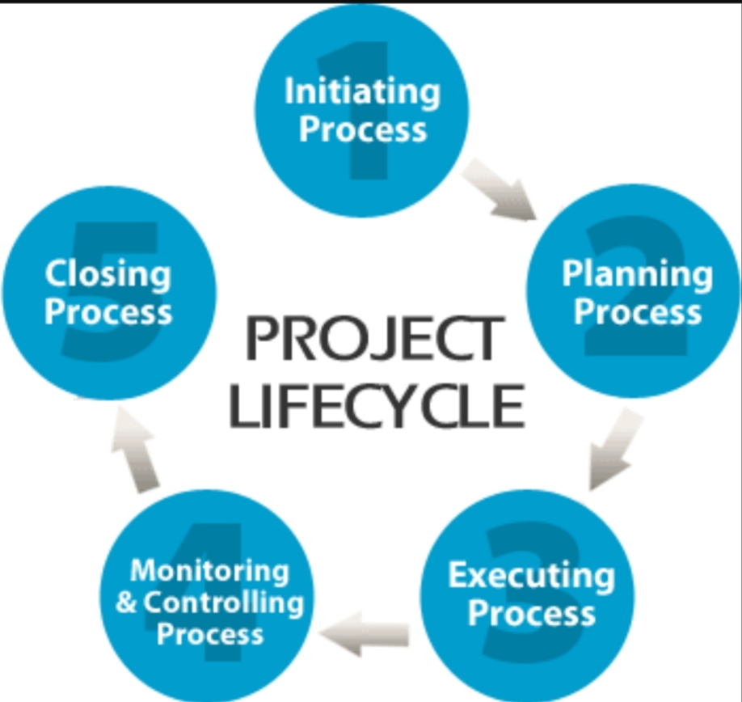

Slide 110
1. Project Initiation
Initiation is the first phase of the Project Life Cycle. This is where the project’s value and feasibility(working ability) are measured. A Project Manager is appointed at this stage who in turn will select the required team members. Project Managers typically use two evaluation tools to decide whether or not to pursue a Project. Those are:
a) Business Case Document- This document justifies the need for the Project and it includes an estimate of potential financial benefits.

Slide 111
b) Feasibility Study- This is an evaluation of the project’s goals, timeline and costs to determine if the project should be executed. It balances the requirements of the project with available resources to see if pursuing the project makes sense.
Teams discontinue the proposed projects that are labelled unprofitable and/or unfeasible. However, projects that pass these two tests can be assigned to a project team or designated project office.

Slide 113
2. Project Planning
Once the project receives the green light, it needs a solid plan to guide the team as well as keep them on time and on budget. A well-written project plan gives guidance for obtaining resources, acquiring finance and procuring required materials. Plan should include a detailed breakdown and assignment of each task of project from beginning to the end. This phase will also include a risk assessment for the successful completion of each task. The project plan gives team direction for producing quality outputs, handling risk, communicating benefits etc.

Slide 114
The project plan also prepares team for the obstacles that might encounter over the course of the project and helps them understand the cost, scope and timeframe of the project.

Slide 116
3. Project Execution
This is the phase that is most commonly associated with project management. Execution is all about building deliverables that satisfy the customers. Team leaders make this happen by allocating resources and keeping team members focused on their assigned tasks.
Execution relies (depends) heavily on the planning phase. The work and efforts of the team during the execution phase are derived from the project plan. The groups become more deeply involved in planning for the final testing, production and support.

Slide 118
4. Project Monitoring and Control
Monitoring and Control are sometimes combined with execution because they often occur at the same time. As teams execute their project plan, they must constantly monitor their own progress.
To guarantee delivery of what was promised, teams must monitor tasks to prevent scope extension, calculate key performance indicators and track variations from allotted cost & time. This constant look out helps keep the project moving ahead smoothly.

Slide 120
5. Project Closure
Teams close a project when they deliver the finished project to the customer, communicating completion to stakeholders and releasing resources to other projects. This important step in the project lifecycle allows the team to evaluate and document the project and move on the next one using previous project mistakes and successes to build stronger processes and more successful teams.

Slide 121
Although Project Management may seem huge/vast at times, breaking it down into these five distinct cycles can help the team to manage even the most complex projects and use time and resources more wisely.

Slide 122
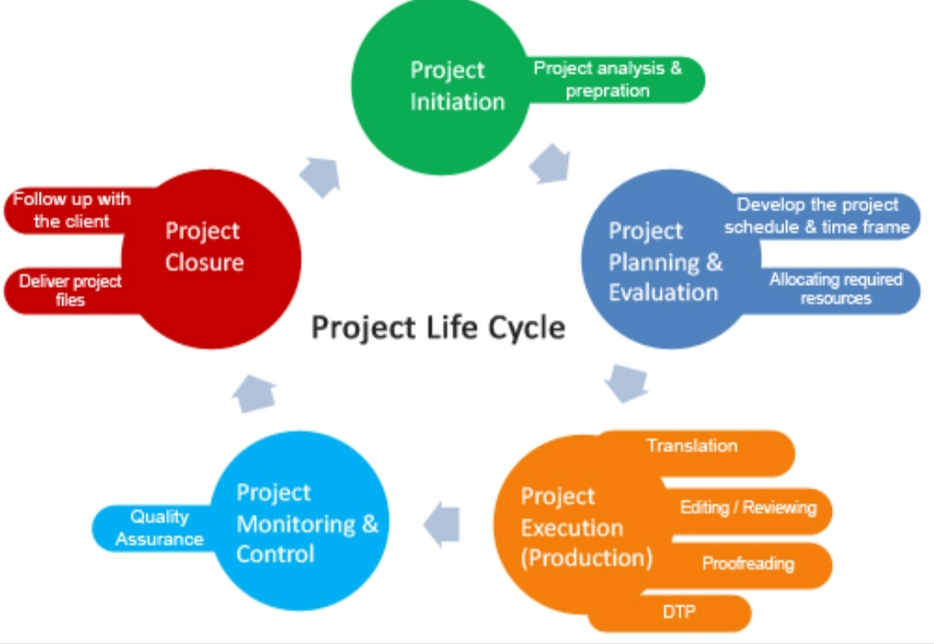

Slide 123
PROJECT MANAGEMENT- AN INTEGRATED APPROACH
Competing in a global market influenced by rapid change, innovation and time to market means, organisations manage more and more projects. Some ways for coordinating and managing projects in this changing environment is needed. Centralisation of Project Management processes and practices has been the practical outcome.

Slide 124
Centralisation gives way to integration of all project processes and practices to improve Project Management. Integration is designed to improve Project Management in the whole organisation over the long run.
“An integrative approach to Project Management is one in which all the parts are interrelated. This approach is important because it can give an organisation a competitive edge in today’s environment. An integrative approach provides an integrated system for the actual implementation of the projects.

Slide 125
The reason for integration of Project Management was to provide senior/top management with:
a) An overview of all Project Management activities.
b) A big picture of how organisational resources are being used.
c) An assessment of the risk.
d) Connecting of top management with actual project execution management.

Slide 126
Project Integration combines all the major dimensions of project management under one roof. Integration means applying a set of knowledge, skills, tools and techniques to a collection of projects in order to move the organisation towards its goal.
Projects are Integrated with the consistent approaches:-

Slide 127
Integration of Project with Process-(Project v/s Process)
Projects and Processes are activities that typically involve multiple steps or tasks being performed in order to meet a business need. There are differences between Project & Processes. The companies need to recognise these differences in order to properly assign their efforts. The key difference is that project has a clearly-defined end, while a process is an ongoing activity which continues as long as organisation understands this difference it becomes easier to understand whether it is a task of an ongoing process or it is viewed as Project related task.

Slide 128
b) Integration of Project with Portfolio Management:
Rather than allowing individual projects to exist, large companies need to take a strategic approach to grouping related projects together and guiding them as a whole towards larger long-term goals.
c) Integration of Project Management with Reporting:
In order for an organisation’s Project Integration Management to be effective in the long term, Project Managers and Teams must share information with stakeholders(Mediators) across the entire company.

Slide 129
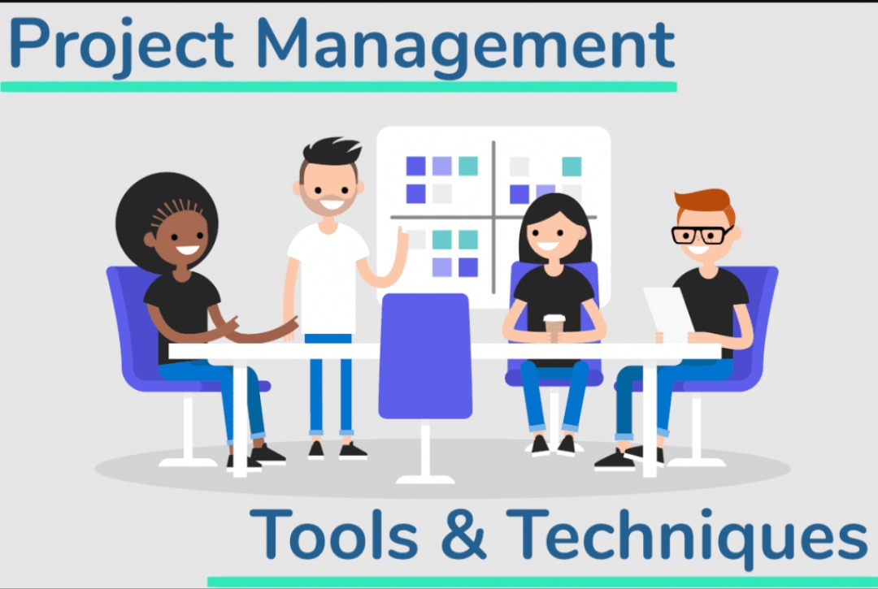

Slide 130
There are numerous Tools & Techniques that are used to aid Project Managers in their challenging task of planning and controlling project activities.
1.Risk Management: In a project environment there is always a risk or chance that adverse conditions occur which could cause the project to fail or fail to meet its planned objectives, eg: time, cost & quality. A project manager should consider the different tasks activities and work to accomplish project deliverables and consider any risk that an actual outcome could differ to an expected outcome.

Slide 131
Models such as PEST or SLEPT analysis and others help to analyse different types of risk. Risk Management processes can also help to identify those risks that are controllable and uncontrollable, then appropriate risk management strategies can be implemented in order to control each risk. This will be a on-going activity throughout the various stages of the project.
Process of Managing Risk involves:

Slide 132
Setting up of Risk Committee to address risk issues
Risk registers are kept with documents
Processes for risk management are reviewed & refined for continuous improvement

Slide 133
2. The Budgeting Process: A budget is a forecast or quantified plan of action. This financial plan of action itemises a projects income & expenditure allocated (i.e planned income & expenses). Budgetory planning creates a budget as part of the planning process for the project. Budgetory control compares the budgeted results as a target in comparison to actual results in order to find out any deviations or variances from the project plan. This process at regular intervals throughout a project can be used to take control action and bring actual results in line with the plans.

Slide 134
Process of Budget’s preparation:
1. A budget Manual
2. A Budget Committee
3. A Budget Officer (accountant)
3. Work Breakdown Structure (WBS): The purpose of work breakdown structure (WBS) is to help efficiently for a project by breaking key tasks or activities down in to more manageable and smaller units of work.

Slide 135
WBS produces a detailed list of tasks to be performed for a project, helping to deliver better costing, scheduling and resource planning for a project.
Benefits:
WBS can be used to allocate and delegate responsibility to accomplish different tasks or activities.
It can be helpful for scheduling the time of different events to improve effectiveness of how time is allocated.

Slide 136
Improves resource planning & the efficiency of how resources are used.
Can be used for risk management.

Slide 137
4. Gantt Charts: It is a time chart devised by Henry Gantt. A Gantt Chart is a horizontal bar chart used for project scheduling. Each activity or task is depicted as a block overtime, actual performance is recorded in real time and compared to planned deadlines necessary for achieving completion.
The use of Gantt charts as a tool:-
It can be used to plan time scale for a project

Slide 138
It can be used to estimate resources required
Graphical illustration of a schedule of tasks to complete
Helps to plan, coordinate and track specific tasks for a project.
Good for small projects when the number of tasks or activities are small and not complex.

Slide 140
5. Critical Path Analysis(CPA) or Network Analysis: Gantt Charts are a poor time management tools when projects are lengthy and complex. There often exists large projects with high interdependency, i.e some activities cannot start until others have been completed first. CPA can display more logically the sequence and timing of each activity, they communicate interdependency and a more effective time management tool for large and complex projects.

Slide 141
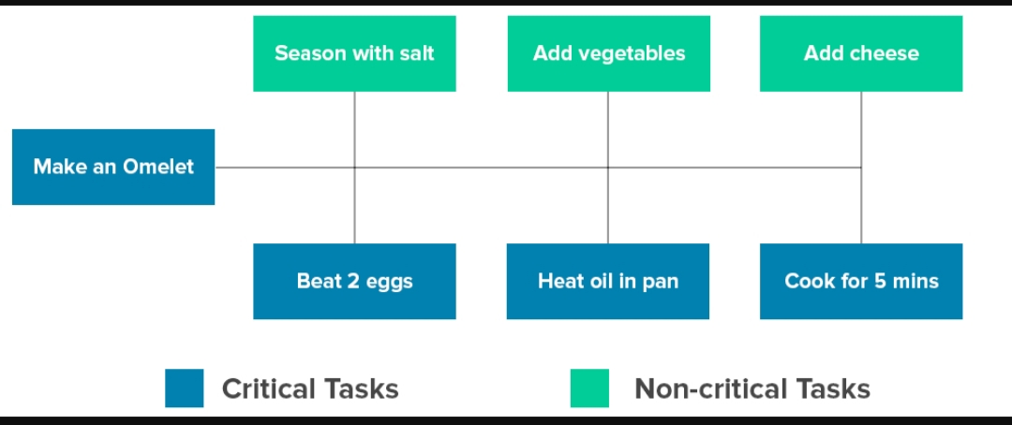

Slide 143
CPA is a good visual communication and planning tool for effective time management. It arranges tasks or activities into optimum sequence of events. It identifies interrelationships between different tasks.
6. Resource Histograms: A resource histogram is a column (or Bar) chart that shows the number of resources assigned to a project overtime. Resource Histograms normally presented as bar charts, can be an effective tool for resource planning and coordinating project staff.

Slide 145
7. Gates and Milestones: Milestones are a completion of major interim goals for a project i.e the key stages of a project from initiation to closure(PLMC)
Gates are significant events or major objectives that have been accomplished at various stages of a project. They assess the key completion or quality of work achieved. Gates are smaller milestones, but well defined into Project Management Process.
The movement of project is not that clear and they often can move, there is a problem following Gates or Milestones.

Slide 146
8. Reports: A Project Initiation Document (PID)/ (Project Proposal Document) is a report to justify a business case for a project, detailing the justification for undertaking it for continuation of it.
A project Initiation Document (PID) is used to define the financial and other benefits which the project is expected to deliver. It also details the cost, time scale and other constraints within which the project is required to operate and against which performance will be evaluated.

Slide 147
A PID normally consists of a project’s technical and resource plan at the beginning of a project and used as a reference tool throughout the project.
9. Project Management Software: Project Management Software in the market today includes Lotus Notes/Domino or Microsoft Outlook/Exchange. These fairly comprehensive and integrated packages provide project applications for time sheets, expense reports, resource management, job costing, help desk services, time reporting and much more.

Slide 148
These softwares help in Project Scheduling, Budgeting & Controlling Cost, Communication and Coordination, WBS, Risk Management, Greater accuracy and ease of updating and reprinting reports.
10. Project Management Systems: Every project should have a plan and set of objective or performance measures to achieve it. Control is needed to ensure what is intended actually comes to be. The aim of good control system is to ensure that the right things get done, so there has to be some kind of plan, standard, budget, instructions or any other target to follow.

Slide 149
It includes:
Staff Training
Clear instructions communicated
Regular inspections, testing & reporting
Quality standards for materials
Quality assurance contracts with suppliers

Slide 150
11. Earned Value Management (EVM): EVM is a project management system that combines schedule and cost performance. EVM is a measurable performance system which provides quantitative data for project decision making and control, it is a systematic project management process used to identify project variances or exceptions by the comparison of work performed and work planned. It is a measurable system for project scope, scheduling and cost, providing an early warning for performance problems.

Slide 151
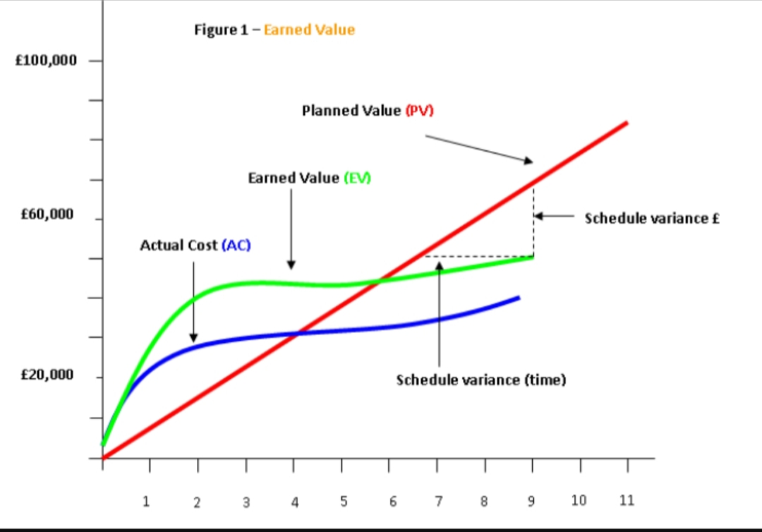

Slide 153
Management Principles Applied to Project Management

Slide 154
Project Management is the discipline of planning, organising, securing, managing, leading and controlling resources to achieve specific goals.
Following are some of the proposed fundamental principles:
1.The Success Principle
The goal of project management is to produce a successful product. Without achieving a successful product there is no merit in incurring the project management cost.

Slide 155
There have been many projects that have been “on time & within budget” but the product has not been successful and similarly many that have not been “on time & within budget” yet the product has been very successful.
2. The Commitment Principle
A mutually acceptable commitment between a project sponsor and a project team must exist before a viable(possible) project exists. A project sponsor is a knowledgeable person representing the eventual owner of the product of the project and who is responsible for providing the necessary resources(money, goods, services and general direction)

Slide 156
A project team is a knowledgeable and qualified group able and willing to undertake the work of the project. A mutually acceptable commitment is one in which there is agreement on the goals & objectives of the project in terms of the product’s scope, quality grade, time to completion and final cost.
3. The Risk-Return Trade Off’s Principle
The core variable of the project management process namely: Product Scope, Quality Grade, Time-to-produce &

Slide 157
cost-to-complete must all be mutually consistent. Scope-Quality-Time-Cost are the 4 miles stones of the project. The project sponsor & the project manager should try to make a balance between these miles-stones in order to minimise the risk. None of the four variables should be affected as they are interrelated.
4. The Primary Communication Channel (or Unity-of-Command) Principle
A single channel of communication must exist between the project sponsor and the project team leader for all

Slide 158
decisions affecting the product of the project. This principle is necessary for the effective and efficient administration of the project commitment.
At any given time, the project’s team must have a single point of responsibility, ‘a project manager’, for the work of the project. Such person must have the skills, experience, dedication, commitment, authority and firmness to lead the project to success.

Slide 159
5. The Cultural Environment (or Suitability) Principle
An informed management must provide a supportive cultural environment to enable the project team to produce its best work. An informed management is one which understands the project management process. A supportive cultural environment is one in which the project is clearly backed by management and project team members are enabled to produce their best work without unnecessary bureaucratic hindrance.

Slide 160
This principle includes the need for management to ensure that the leadership profile and management style are suited to both the type of project and its phase in the project life-cycle.
6. The Process Principle
Effective & efficient policies and procedures must be in place for the conduct of the project commitment. Such policies and procedures must cover at a minimum clear roles and responsibilities, delegation of authority and process for managing the scope of work including changes, maintenance of quality and schedule and cost control.

Slide 161
7. The Life-Cycle Principle
Plan first and then do. A successful project management process relies on two activities- planning first and then doing. These two sequential activities form the basis of every project life-cycle and can be expanded to suit the control requirements of every type of project in every area of project management application. The project life-cycle characterized by a series of ‘miles-stones’ determines when the project starts, the control gates through which it must pass and when the project is finished.

Slide 162
Project plan

Slide 163
A project plan is a statement of how and when a project’s objectives are to be achieved by showing the major products, milestones, activities and resources required on the project. The project manager creates the project management plan.
Project Integration Management
It describes the process required to ensure that the various elements of the project are properly coordinated. It consists of project plan development, project plan execution & integrated change control.

Slide 164
Elements of Project
Projects come in all shapes and sizes from small, simple ones to larger and more complex projects. Whatever the size or type of project, there are 5 essential elements that are considered in order to achieve a successful outcome.
Whether the project is about improving an existing product or service, managing change or implementing a new system, the same elements are required to manage the projects.

Slide 165
In order to ensure all projects reach the required level of success, here are the five essential elements that need to be included:
1. Strategic Planning: It is the first stage of any project, is to understand the need for the project and what it is trying to achieve. SMART objectives (Specific, Measurable, Attainable, Relevant, Timely) need to be established. Internal project manager will require close relationship with departments to establish and set commonly agreed objectives.

Slide 166
2. Product Development: The variety of activities that are judged/regarded to be projects are wide and varied and can include new products, processes and services. The development of any of these needs to be closely linked to meet defined business objectives and adding value to the organisation. The benefits of a project should be well said at the beginning so there will be a clear link to the success of the project and the impact on overall business aims.

Slide 167
3. Communication: It is very important to sell the benefits of any project to those who will be affected during the project or by the project’s final outcome. The end (final) users must understand why the project is beneficial and potential buyers need to be convinced by the advantages of new products and services. Communicating the message of why a new or different project is good will help to face the typical human resistance to change.

Slide 168
4. Resources: It is important to ensure that adequate resources in terms of people, time, finances and equipments are in place. This could involve the IT department providing the appropriate hardware/software, Human Resources recruiting the necessary people or the activities department providing offices or other relevant support. There also needs to be allocated budgets and finance as well as appropriate timelines for project completion.

Slide 169
5. People: No project manager works in isolation. There are many stakeholders involved in a project who all have a specific role to play and who all have a dedicated interest in the project’s success.
The stakeholders involved in projects and help make the projects success include:
a) Sponsor: He is a person who defines the business objectives that drive the project. The sponsor can be a member of the senior management team or someone from outside the organisation.

Slide 170
b) Project Manager: A professional project manager creates the plan and ensures that it meets the budget, schedule and scope determined by the sponsors. The project manager is also responsible for risk assessment and management.
c) Project Team Members: These can include subject area experts, members of departments, external professionals and new recruits. Anyone who can offer a positive contribution to the project in terms of their knowledge and capabilities makes a good team member.

Slide 171
Why projects?

Slide 172
Projects create productive assets. It is only through projects, resources are converted into productive assets. They act as prime-movers of economic development of any country.
Projects can be successfully completed only with a focused attention on goals by the project team members, projects create an environment for participatory endeavors.
From the point of view of an organisation, projects act as a means for consolidating the experience and expertise of the organisational members effectively, create learning environment, encourage organisational objectives.

Slide 173
Business becoming more & more competitive, the focus of organisations shift towards ensuring customer satisfaction. This can be achieved by cutting down costs, improving quality, improving product features & ensuring timely delivery. This is possible through mass production, but when every organisation switches over to mass-production, the cost differences between orgsnisations get narrowed down. In such a situation, there needs to be a shift towards custom production of products & services to meet the specific customer requirements.

Slide 174
Such a situation will necessarily require a team-based approach-where ‘project management’ becomes the only option. Some specific and time-bound issues can be effectively handled only by project based organisations.
As organisations start handling more of projects, the bureaucratic organisational set up where project teams will be formed to execute specific projects.

Slide 175
Once the project execution is over, the team will be dissolved and a fresh team will be formed to handle a new project and so on.
So projects have come to stay in handling organisational activities.
*************

